Slide 1
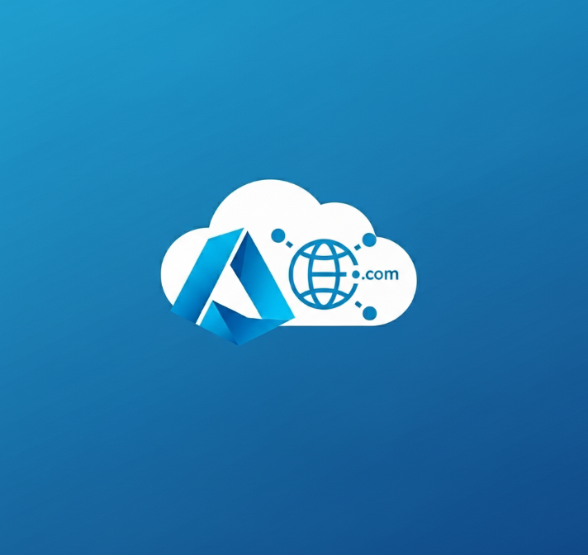
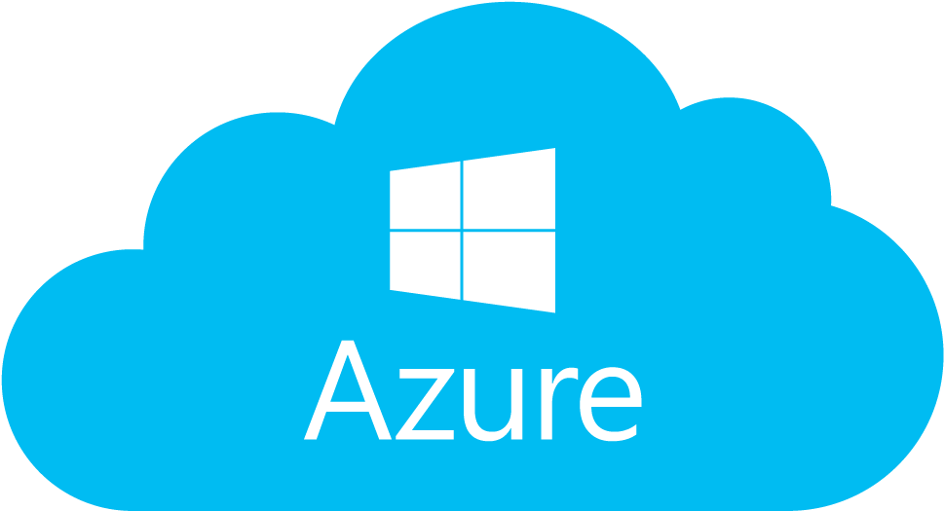
App Service Domain
📢Buy your domain via Azure Portal

Slide 2
Buy your Domain via Azure Portal
What is the benefit of getting your domain via Azure Portal ?
Microsoft allows you to create your domain via the app service domain resource. Behind the scene your domain you own it and is bought from GoDaddy. Why purchase a domain through the Microsoft Azure portal instead of directly from GoDaddy?
While domains acquired via Azure are ultimately registered through GoDaddy, purchasing them through the Azure portal offers several strategic advantages, particularly for organizations leveraging Azure services:
Manage everything from one portal
Ease of use with IAC
You can manage DNS zones directly with Terraform, Bicep, or ARM templates.
Having one billing + Access Control
You can manage costs centrally using Cost Management + Billing in Azure, in addition to RBAC.
Automatic DNS Zone creation
This means you don’t need to manually configure DNS records, Azure can do it for you when linking the domain to an App Service.
SSL Certificate Management
Azure can automatically issue and renew free App Service Managed Certificates for domains purchased through the portal.
One-Click Domain Assignment
When deploying a web app, you can assign the domain directly from the App Service blade without needing to copy records or validate ownership manually.

Slide 3

Azure Demo
App Service domain

Slide 4
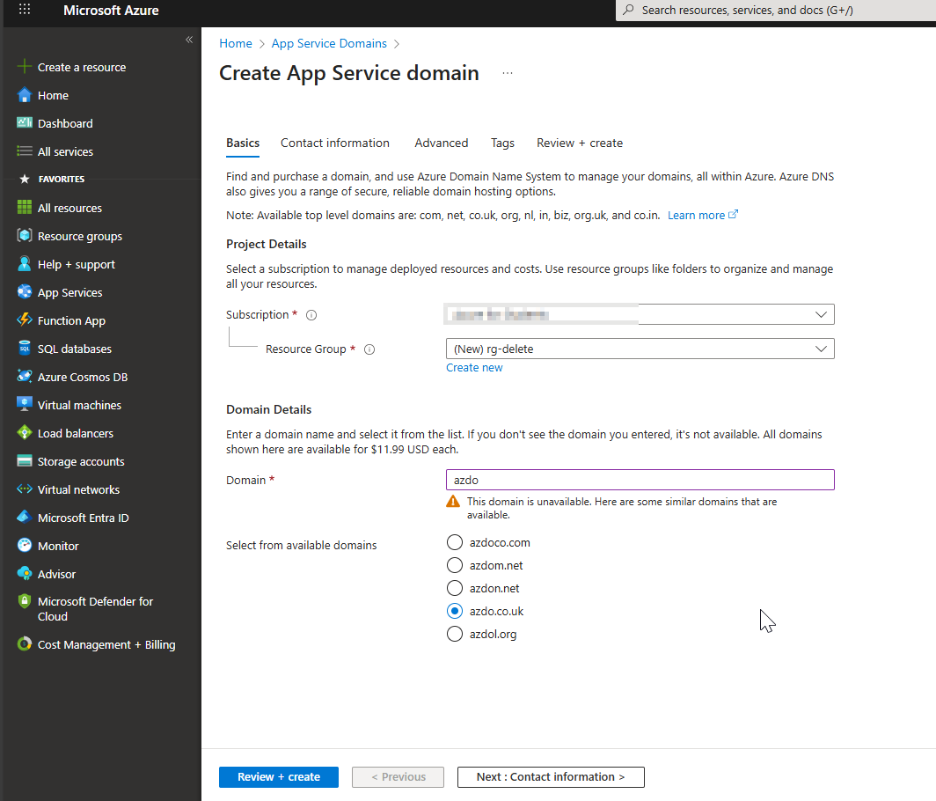
Prerequisites:
Azure subscription Enterprise or PAY as You GO.
PS: Subscription of Devoteam Visual Studio Enterprise doesn’t work.
Choose App Service Domain from the search bar
Click on Create
Fill the information required
Click on Review + Create

Slide 5
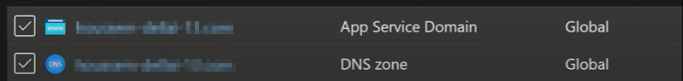
Once the App Service domain is provisioned, two associated resources will be automatically created and available within your Azure environment.

